Slide 1

Digitalizing Global Mobility
Accelerating GBS Transformation | Abdullah Çalışkan

Slide 2
The Vision: "To-Be" Digital Workflow
🔴 AS-IS (Current Manual Process)
📧 Request via Email
📝 Manual Data Entry to Excel
🧮 Manual Calculation (Duration)
📄 Unstructured Reporting
🟢 TO-BE (Proposed Automated Process)
📋 Structured Request (MS Forms)
🐍 Python Script (Logic & Calc)
🧮 Manual 📂 Automated Data Pipeline (Duration)
📈 Live Power BI Dashboard

Slide 3
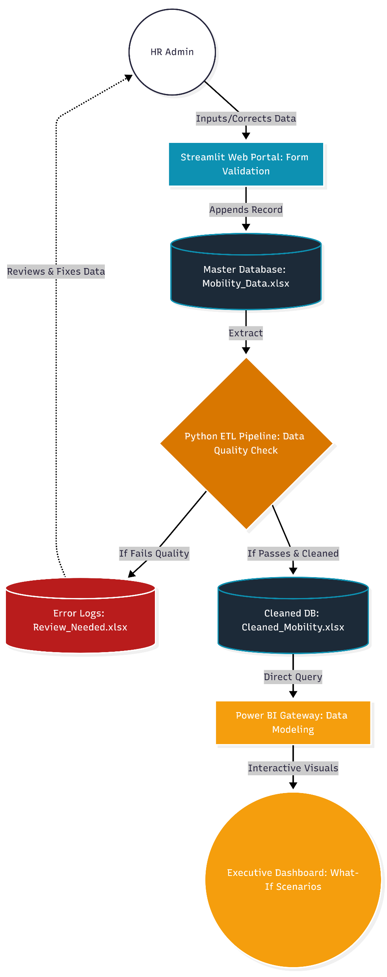
System Architecture Overview

Slide 4
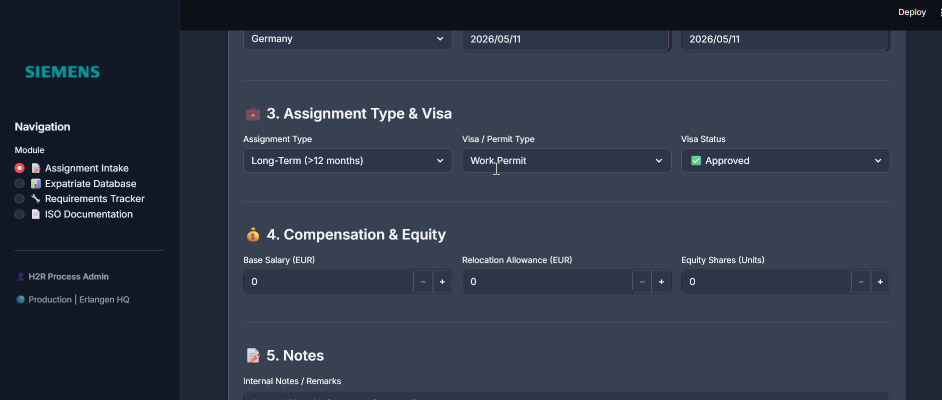
Phase 1: Smart Data Intake & Validation (Frontend)

Slide 5
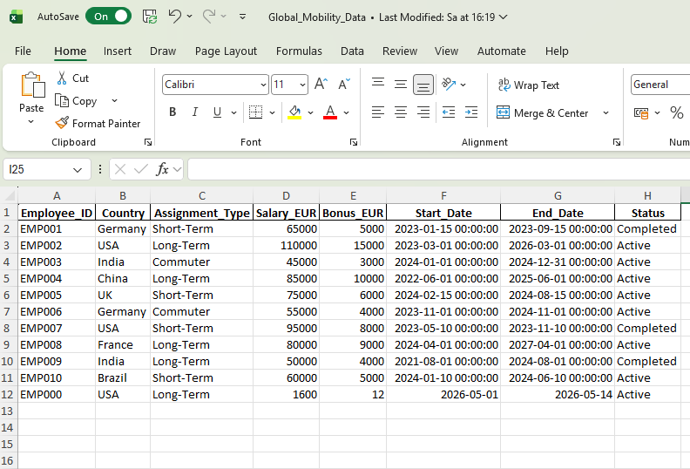
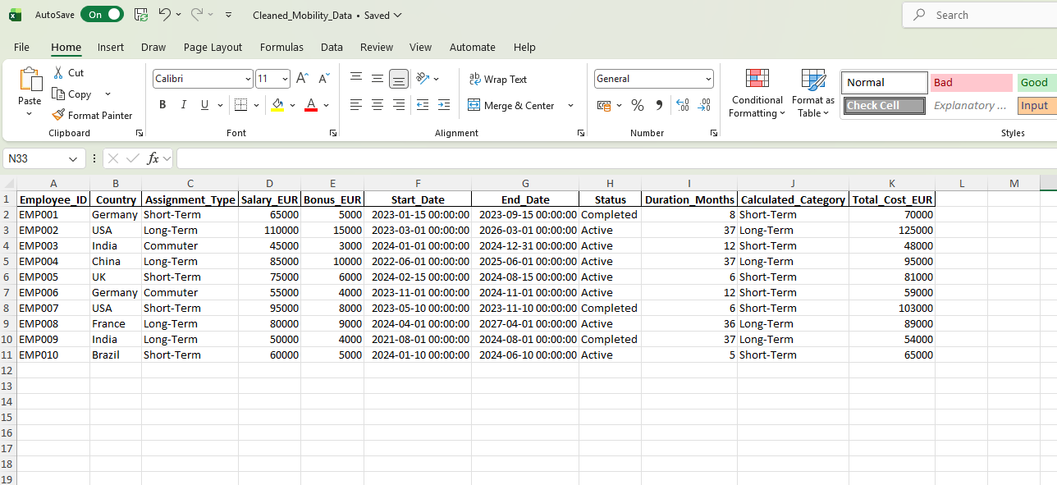
Phase 2: Automated ETL & Exception Handling (Backend)
Python automatically validates raw data, pushing clean records to Power BI while isolating logical errors into a feedback loop for HR review.

Slide 6
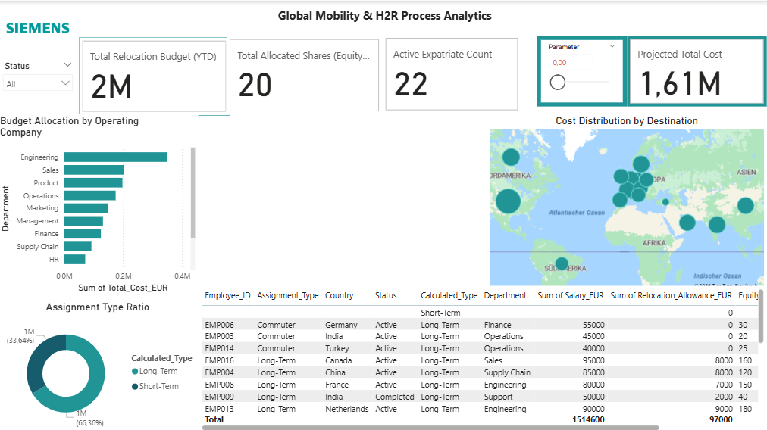
Phase 3: Executive Analytics & Insights (Power BI)

Slide 7
99%+ Data Integrity
Smart validation eliminates human error at the source (e.g., negative salaries, inverted dates).
Zero-Touch Reporting
Real-time Power BI synchronization replaces days of manual Excel consolidation.
100% Audit Readiness
Process Scalability
The automated Python ETL pipeline can effortlessly scale to process thousands of expatriate and equity records without requiring additional HR headcount.
Business Impact & Value Delivered

Slide 8
THANK YOU

